Slide 1
Integrated Project -I
Progress 1 Presentation
On
MessMate: Digital Mess Management System
Presented by:
Under Guidance of: Dr. [Guide Name] (Class Teacher)
Team Member 1 | Team Member 2 | Team Member 3
Aakash Rana | Aditya Antwal | Anubhav
2311981005 | 2311981035 | 2311981098
Notes:
MessMate: Digital Mess Management System. Progress 1 presentation by Aakash Rana, Aditya Antwal and Anubhav.

Slide 2
Brief Outline
I. Introduction
A. Overview of the Project
B. Objectives and Goals
II. Project Scope
A. Key Deliverables
B. Literature Survey
C. Gap Analysis
III. Methodology and Design
A. Agile Timeline
B. Tech Stack and Requirements
C. System Design and QR Flow
IV. Progress Overview
A. Completed Modules
V. Achievements
A. Milestones Achieved
B. Test Results
VI. Future Plans
A. Upcoming Tasks
B. Planned Enhancements
VII. Conclusion
A. Summary of Progress
B. References
Notes:
Outline: introduction, scope, methodology and design, progress, achievements, future plans and conclusion.

Slide 3
Introduction
MessMate is an end-to-end, web-based digital mess management and automation system for institutions such as Chitkara University. It replaces manual registers with centralized, role-based workflows and real-time analytics.
Problems with manual mess operations
Paper wastage
Physical registers for entries, stock and billing.
Inaccurate forecasting
No prior headcount estimate before cooking starts.
Food overproduction
Surplus meals are prepared and then discarded.
Slow complaints and billing gaps
Slow grievance handling and unaccounted billing discrepancies.
Goal: minimize food wastage, enable precise meal planning, improve student satisfaction and automate administrative and financial processes.

Slide 4
Objectives & Goals
1
Minimize food waste through dynamic booking and demand forecasting
2
Automate attendance with QR-based entry verification
3
Bring supply-chain transparency through inventory tracking
4
Ensure financial accountability with digital wallets
5
Close the loop on complaints through ticketed grievance redressal
Four user roles
Student
Meal booking, digital wallet, ratings and feedback
Mess Staff
QR entry scanning, duty allocation, live check-ins
Mess Manager
Stock logs, demand forecast, waste analytics
System Admin
User management, audit logs, RBAC control

Slide 5
Key Deliverables
Access and Dashboards
Role-based access control for four roles, each with a tailored dashboard of KPIs and actionable widgets.
Menus and Meal Booking
Weekly menus across Breakfast, Lunch, Snacks and Dinner; opt-in or opt-out before time cut-offs.
QR Attendance
Dynamic student QR codes verified instantly by staff, with real-time check-in tracking.
Inventory and Supply
Stock tracking with low-stock alerts, plus supplier directory and purchase logs.
Feedback and Grievances
1 to 5 star meal ratings with comments; complaint tickets tracked from Pending to Resolved.
Analytics and Payments
Demand forecasting, waste logging, wallet ledger, invoicing and CSV, Excel or PDF reports.

Slide 6
Literature Survey
Manual ledger systems | Sharma & Verma (2019)
Paper logs show a 15 to 20% accounting error margin and cause heavy food waste because there is no prior headcount forecasting.
Standalone desktop applications | Kumar & Singh (2020)
Offline database tools lack real-time student interaction, such as instant cancellation or live menu alerts.
QR and RFID entry tools | Patel et al. (2021)
QR-based gates reduced entry queues, but lacked supply-chain management, financial wallets and waste analytics.
Gap: no unified ecosystem bridges students, kitchen staff and management. MessMate combines booking, QR attendance, inventory, wallets and forecasting on one platform.

Slide 7
Gap Analysis
Aspect | Traditional Mess | Existing Desktop Tools | MessMate (Proposed)
Meal Planning | Fixed / manual logs | Static digital menu | Dynamic booking and cut-off cancellation
Demand Forecasting | Static guesswork | Basic statistical average | Booking data with historical trend forecasting
Attendance | Manual signature registers | Basic RFID / barcode entry | Instant QR code verification
Feedback and Grievances | Physical register / suggestion box | Google Forms / e-mail | Integrated rating engine and ticket tracker
Inventory Tracking | Paper ledger | Basic Excel sheets | Automated low-stock alerts and supplier logs
Waste Management | Unmonitored disposal | Unmonitored disposal | Daily waste logging and sustainability analytics

Slide 8
Methodology & Timeline
Agile SDLC: iterative sprints over a 12-week schedule
Weeks 1-2
Phase 1: Requirements and Architecture
Module specifications, workflow diagrams, ER diagram and normalized schemas
Weeks 3-4
Phase 2: Backend and Authentication
Express server setup, REST routes and JWT authorization for multi-role access
Weeks 5-8
Phase 3: Frontend and Core Features
Responsive dashboards, QR scanner, booking, inventory and wallet UI
Weeks 9-10
Phase 4: Forecasting and Analytics
Operations reports, demand forecasting, global search and dashboards
Weeks 11-12
Phase 5: Integration and Deployment
Unit and integration testing, cross-device checks, deployment and documentation

Slide 9
Tech Stack & Requirements
Layer | Technology
Frontend | HTML5, CSS3, JavaScript (ES6+), responsive grid layouts with CSS variables
Backend | Node.js with Express.js (RESTful API server architecture)
Data and Storage | JSON-backed persistence with MongoDB / PostgreSQL support
Security and Auth | JSON Web Tokens (JWT) and BCrypt password hashing
Visualization | Custom JavaScript canvas chart engine for real-time dashboards
Software
Windows 10/11, macOS or Linux
Node.js v18+ and Express.js v4.x
VS Code, Git and GitHub
Postman / Insomnia for API testing
Hardware
Core i5 / Ryzen 5, 2.4 GHz or higher
8 GB RAM (16 GB recommended)
256 GB SSD, 10 GB free space
Full HD monitor; phones for QR tests

Slide 10
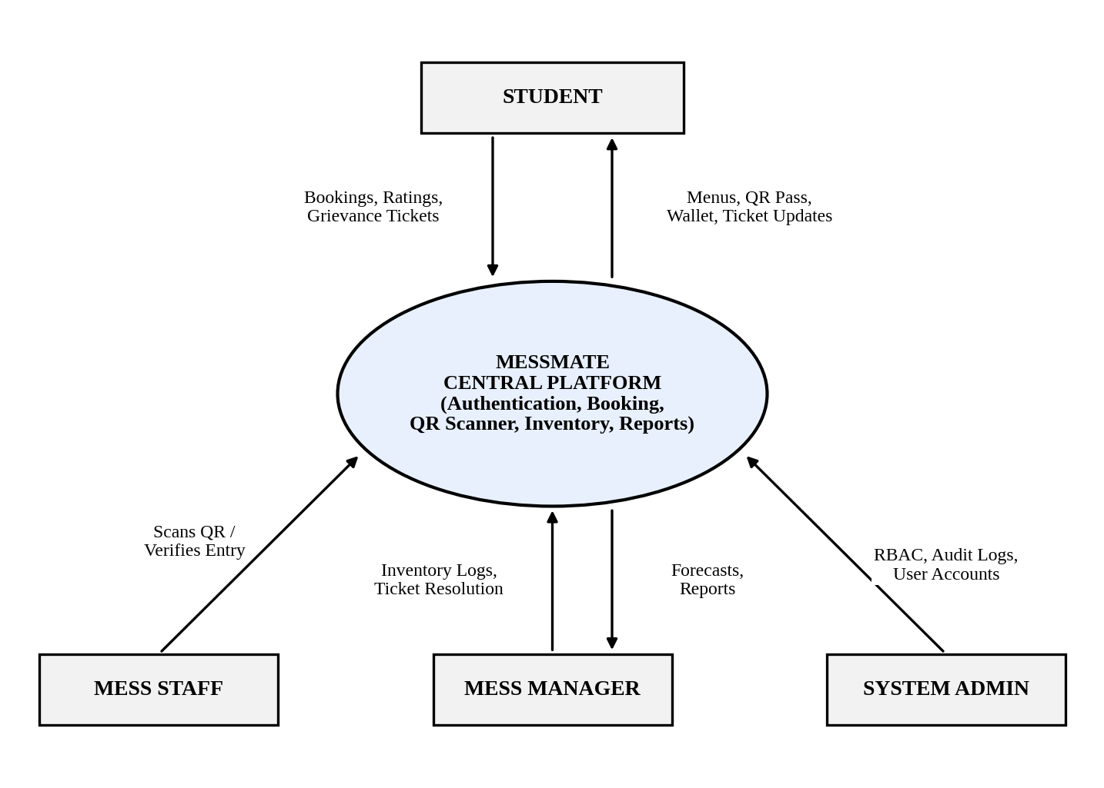
Context Diagram (Level 0)
One central platform serves four external entities (Students, Mess Staff, Mess Managers and System Admins), exchanging bookings, QR scans, inventory logs, forecasts and audit data.

Slide 11
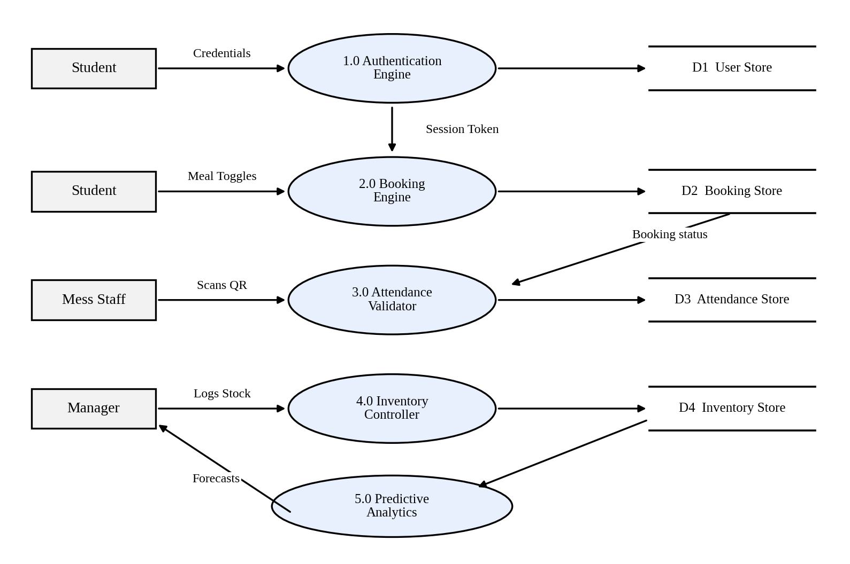
Level 1 Data Flow Diagram
Five processes (Authentication, Booking, Attendance Validator, Inventory Controller, Predictive Analytics) read and write four data stores: User, Booking, Attendance and Inventory.

Slide 12
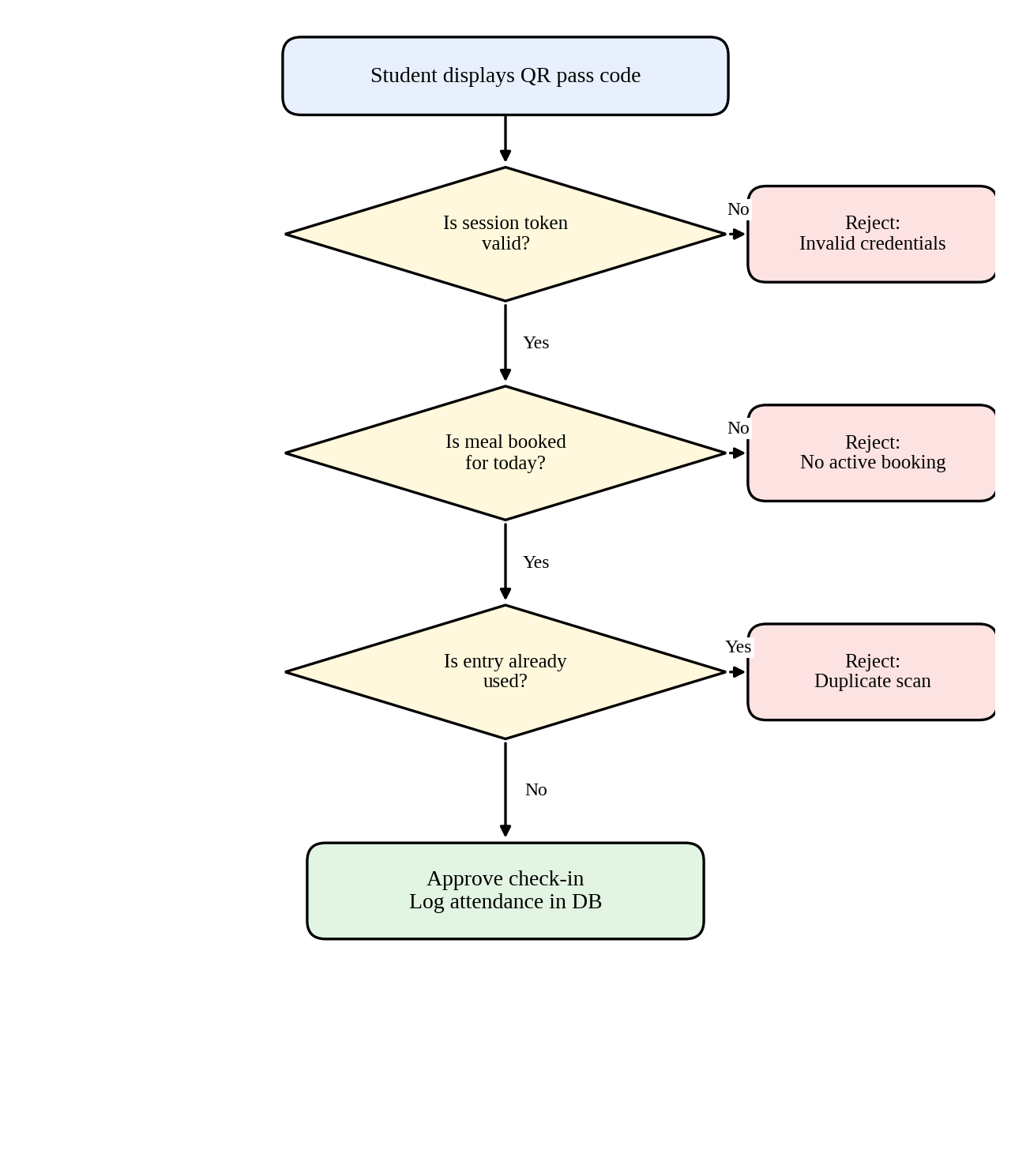
QR Verification Workflow
Student dashboard generates a dynamic QR tied to ID, session and date
1
Staff scan the code with a web camera or handheld device
2
System checks token validity, an active booking for the slot and no prior entry
3
Approved: meal marked CONSUMED and attendance updated live. Duplicate: visual and audible alert
4

Slide 13
Progress Overview
Module | Core features implemented | Status
Authentication and RBAC | JWT auth, password hashing, multi-role route guarding | 100%
Student Dashboard | Menu view, meal opt-in/opt-out, QR generator, wallet UI | 100%
Staff Dashboard | QR scanner simulation, entry validation, daily checklists | 100%
Manager Dashboard | Inventory tracker, demand forecasts, complaint resolver | 100%
Admin Dashboard | User role assignment, system auditing, RBAC rules | 100%
Grievance Module | Ticket creation, categorization, status progress updates | 100%
Operations Reports | Attendance analytics, wastage logging, PDF/Excel exports | 100%
Global Search Engine | Cross-module field search, multi-column filtering | 100%
All 8 planned modules are implemented as of the mid-term review.

Slide 14
Achievements
8 / 8
modules completed
8 / 8
test cases passed
4
user roles secured with RBAC
ID | Module | Scenario and expected outcome | Result
TC01 | Auth | Valid login issues a JWT and redirects to the dashboard | PASS
TC02 | RBAC Security | Admin page without a JWT is denied and redirected to login | PASS
TC03 | Meal Booking | Toggle before cut-off sets status to OPTED_IN | PASS
TC04 | Cut-Off Engine | Cancelling lunch after 09:00 is disabled with a warning | PASS
TC05 | Attendance | Valid QR scan verifies entry; status becomes CONSUMED | PASS
TC06 | Attendance | Repeat scan for the same meal slot is rejected | PASS
TC07 | Inventory | Stock below threshold shows a low-stock banner | PASS
TC08 | Grievance | Ticket with image attachment is logged as Pending | PASS

Slide 15
Future Plans
Upcoming Tasks (Weeks 11-12)
System integration across all modules
End-to-end and integration testing
Cross-device responsiveness verification
Final deployment and documentation of system workflows
Planned Enhancements
Replace the prototype in-memory store with MongoDB / PostgreSQL
Connect physical QR scanners or RFID readers through the REST API
Online payments with automated receipts
Sustainability and carbon-footprint tracking
Next milestone: complete Phase 5 with full integration, testing and deployment of MessMate.

Slide 16
Conclusion & References
Summary of progress
MessMate digitizes mess operations end to end for four user roles.
All 8 planned modules are complete and all 8 test cases pass.
Remaining work: final integration, deployment and planned enhancements.
References
Sharma, A., & Verma, R. (2019). Challenges in Hostel Administration and Mess Operations in Higher Education Institutions. J. Campus Administration & Technology, 12(2), 45-58.
Kumar, P., & Singh, S. (2020). Design and Development of Web-Based Smart Mess Management System. Int. J. Computer Applications, 178(14), 22-29.
Patel, K., Mehta, M., & Shah, D. (2021). Automated Mess Access Control using QR Code Verification. IEEE Trans. Consumer Electronics & Smart Campus, 67(3), 201-209.
Documentation: Express.js (expressjs.com), Node.js (nodejs.org), MongoDB (mongodb.com/docs), PostgreSQL (postgresql.org/docs).

